Slide 1
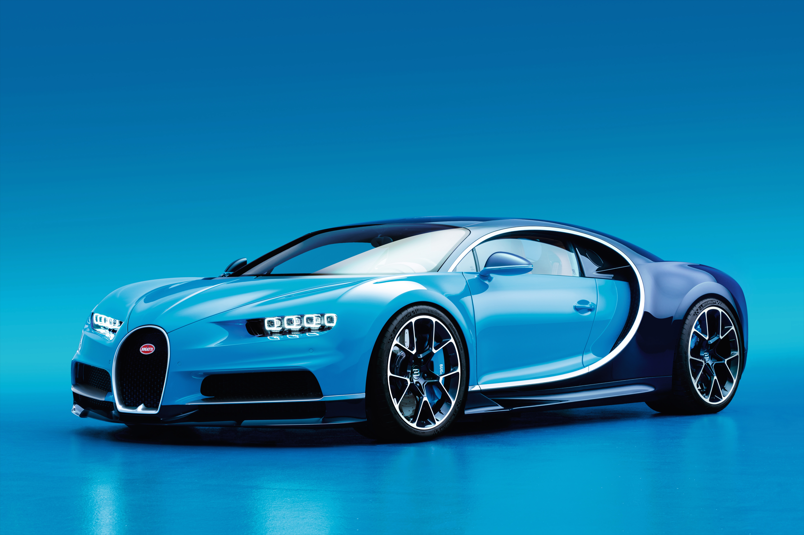
CAR PRICE PREDICTION
CAR PRICE PREDICTION
Team -3

Slide 2

TEAM -3
Srinadh
Vijay Karthik
Satya
Alekhya
Sampath
Sai kiran
Krishna
Rakesh

Slide 3
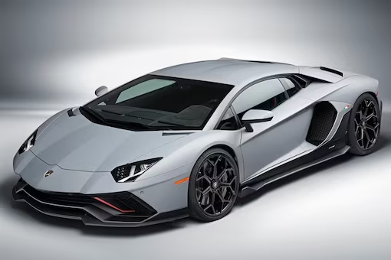



DATA SET
Cars data set
LANGUAGES
FRONTEND:
BACKEND:

Slide 4
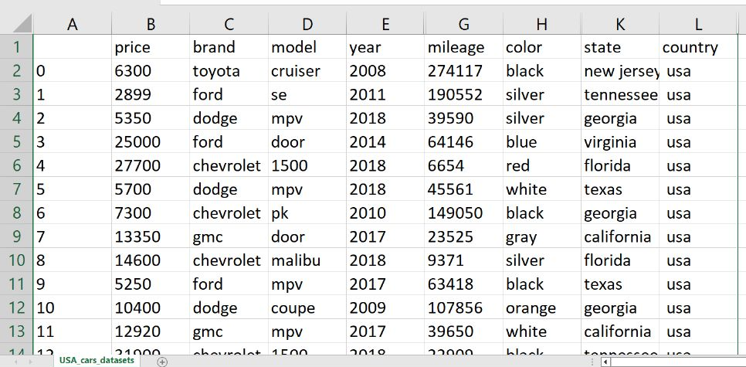

Slide 5
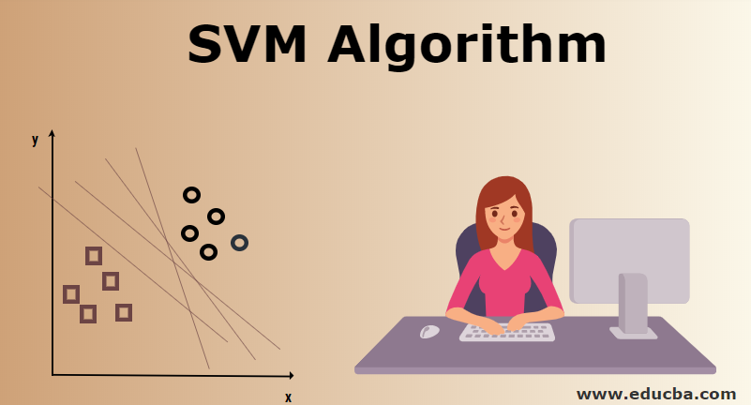
SUPPORT
VECTOR
MACHINE

Slide 6
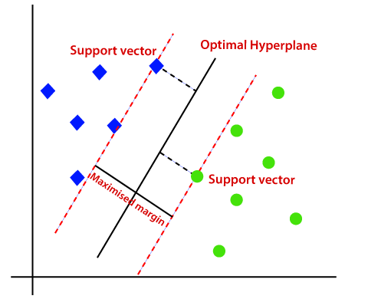
SUPPORT VECTOR MACHINE (SVM) :
It Is a most popular supervised learning algorithm.
It is used for both classification and regression.
We are mainly using SVM for classification which is known as SVC
The goal of SVM algorithm is to create the best line or decision boundary that can segregate n-dim space in to classes
So that we can easily put the new data point in the correct category.

Slide 7
FLOW CHART
START
Importing
Data Set
Importing libraries
Exploratory data analysis
Loading data sets
Data preprocessing
Building and training the models
End
Making prediction on unknown dataset
Selecting the best model

Slide 8
CAR PRICE PREDICTION
Engine CC :
Air bags :
Year :
Milage :
Color :
SUBMIT

Slide 9
CAR PRICE PREDICTION
Engine CC :
1000
Air bags :
12
Year :
2016
Milage :
22.5 KMP/LIT
Color :
Black
Price :
99,90,000

Slide 10


